Slide 1
Find grub
A Restaurant Finder App

Slide 2
Project members
Alex Legard
Alan Belgraves
Pawan Joshi

Slide 3
Roles
Front End : Alan Belgraves
Back End : Alex Legard
Back End : Pawan Joshi

Slide 4
Why php & MYSQL
Technologies Used:
Front End: HTML, CSS, Bootstrap
Back End: PHP, MySQL
API Integration:
Zomato API
Google Maps API
Google Directions API
It is open source, platform-independent, faster and has huge community for libraries
Composer is a widely loved package manager
Ease of use for beginners
Provides an interactive, user friendly website
Dynamic pages with customized features

Slide 5
introduction
Find Grub - is a web application to find the restaurants in your city.
User can search for restaurants by location.
Search results come up, using Zomato API.
Display detailed information including ratings, cuisines and locations using Google’s Directions API.
Zomato APIs give access to 1.5 million restaurants across 10,000 cities globally.

Slide 6

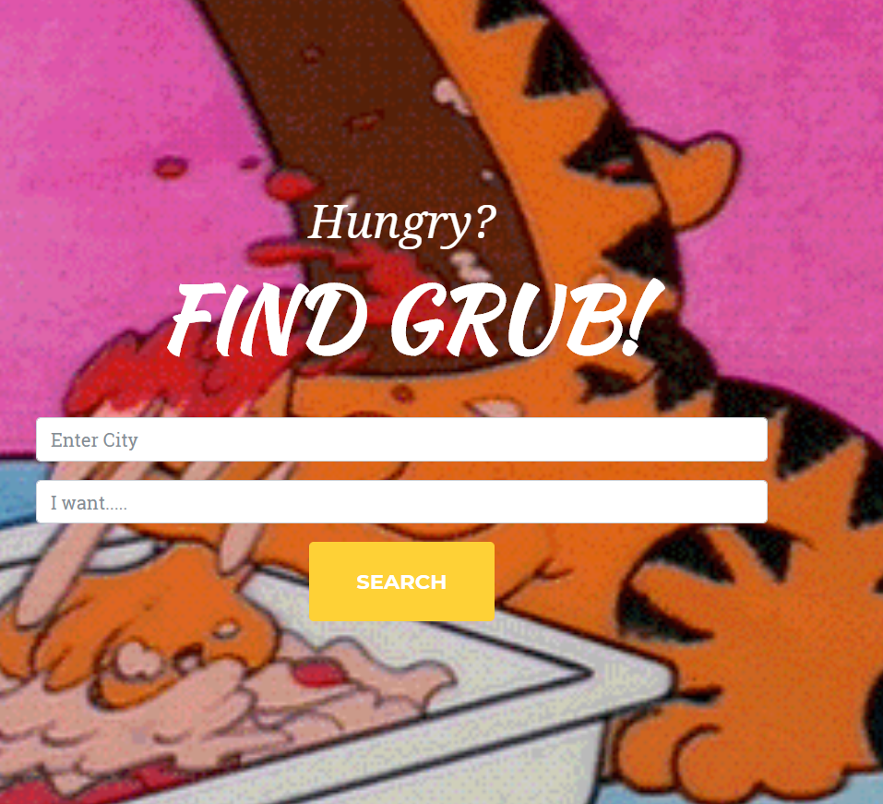

Interface
Google like Search Page
Easy to Use
Users can search for City and press Search Button

Slide 7
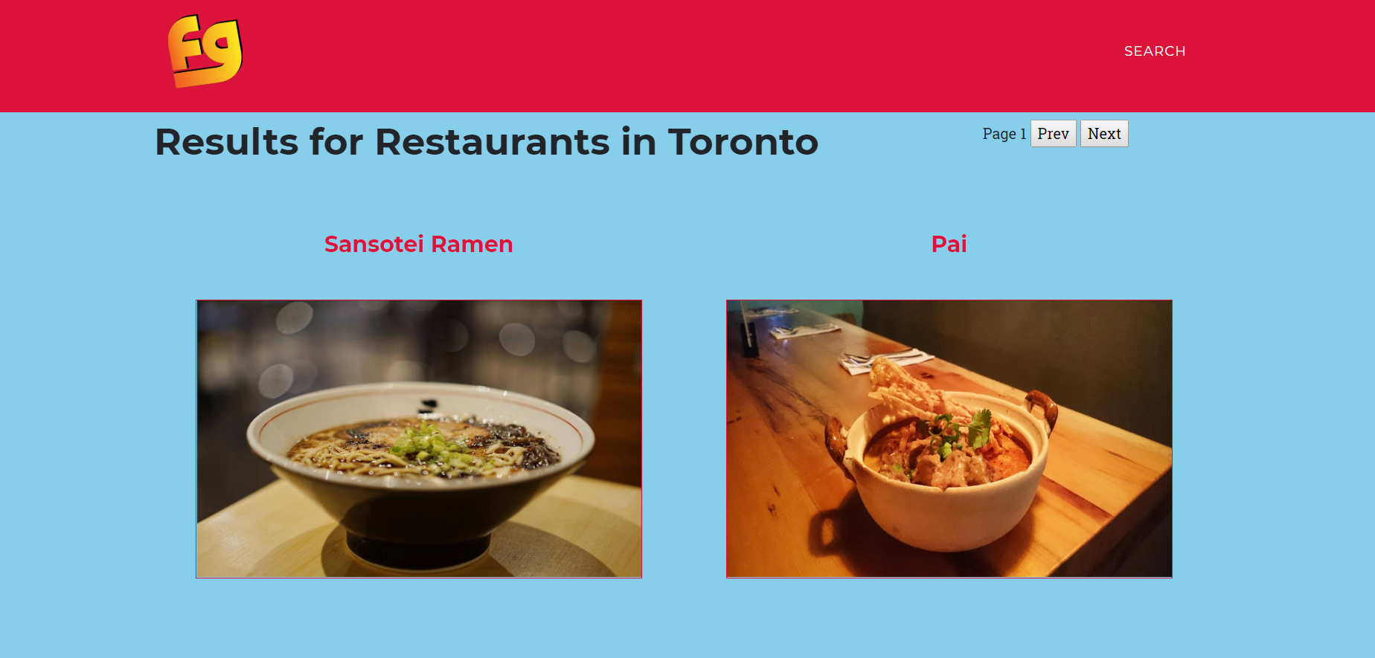
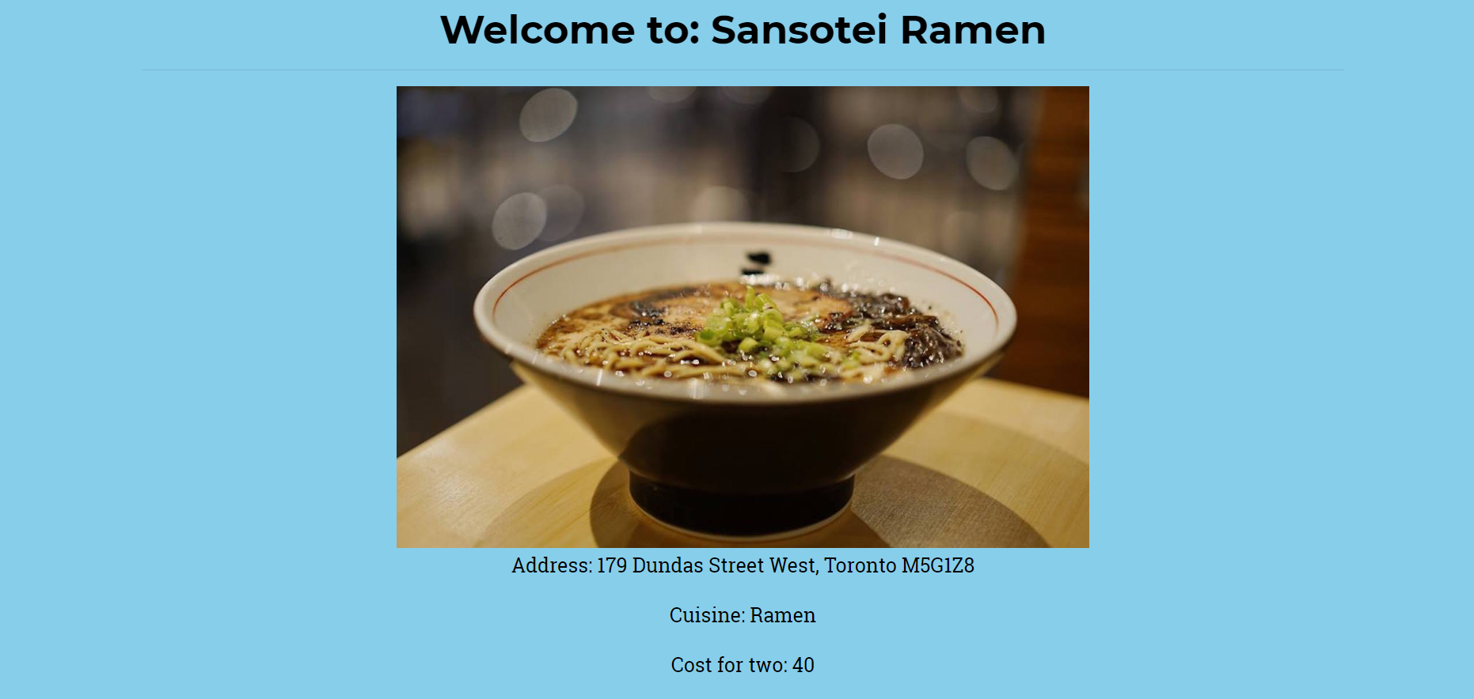
Search results

Slide 8
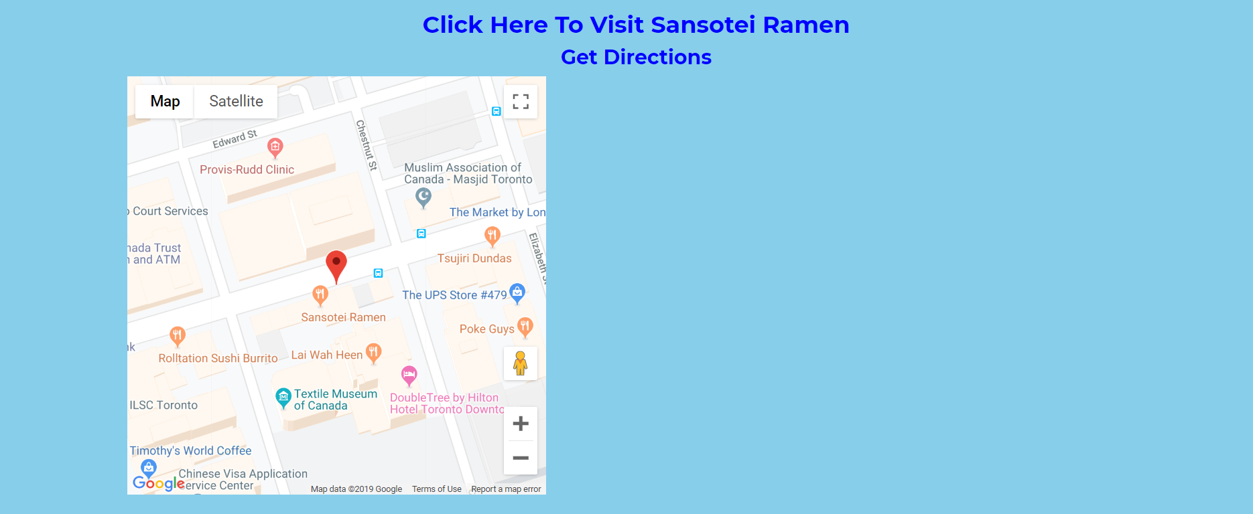
Directions

Slide 9
Project scope
Future enhancement for this project is to make it more like Uber Eats or Skip The Dishes Application
Create Log In and Register where user’s information can be stored.
Integrate online delivery system. Users can sign in with Google.
Provide Food Delivery to customers.

Slide 10
Questions???

